Slide 1
NorTex Petroleum Cluster:
Mobility Control by CO2 Foam – from Lab to Field Pilot in Texas
by
Prof. Arne Graue
Dept. of Physics and Technology
University of Bergen, NORWAY
Rice University's Consortium for Processes in Porous Media, Houston, TX, USA, April 21st, 2014.

Slide 2
Research Partners:
4 Universities in Texas, USA
Rice University, Houston, TX, USA
University of Houston, Houston, TX, USA
University of Texas at Austin, Austin, TX, USA
Texas A&M University, College Station, TX, USA
3 Universities in Norway:
University of Bergen, Bergen, Norway
University of Stavanger, Stavanger, Norway
NTNU, Trondheim, Norway
Industry partners
Statoil Petroleum ASA
Schlumberger

Slide 3
Objectives
Strengthen and coordinate petroleum research and education in Norway and Texas
Emphasize industry challenges in academia
How:
Improve communication: industry and academia
Provide industrial lecturers at the universities
Support student and faculty exchange
Assist in facilitating industry funding

Slide 4
NorTex Petroleum Cluster Board Members and Deputies
Elected Chairman of the Board:
Prof. Arne Graue, Dept. of Physics and Technology, U. of Bergen, Norway
Deputy: Prof. Tor Arne Johansen, Dept. of Earth Science, U. of Bergen, Norway
Board Members:
Prof. Tad Patzek, Department Chair, Dept. of Petr. and Geosystems Eng., UT at Austin, TX, USA
Deputy: Prof. Ron Steel, UT at Austin, TX, USA.
Prof. Dan Hill, Department Head, Dept. of Petr. Eng., Texas A&M Univ., TX, USA.
Deputy: Assoc. Prof. David Schecther, Dept. of Petr. Eng., Texas A&M Univ., TX, USA.
Svenn Ferry Utengen, Vice President Unconventional, Texas Area, Statoil, USA.
Deputy: Bruce Tocher, Manager Unconventional Hydrocarbons, Texas Area, Statoil, USA.
Najib Abusalbi, Corporate University Relations Manager, Schlumberger, Houston, TX, USA
Prof. George Hirasaki, Dept. of Chemical and Biomolecular Eng., Rice U., TX, USA.
Deputy: Ass. Prof. Lisa Biswal, Dept. of Chem.. and Biomolecular Eng., Rice U., TX, USA
Prof. Tom Holley, Director, Petr. Eng. Program, U. of Houston, TX, USA.
Deputy: Mike Nikolaou, Assoc. Prof. of Chemical Engineering, University of Houston
Prof. Svein Skjæveland, Dept. of Petr. Eng., U. of Stavanger, Norway
Deputy: Assoc. Prof. Merete Madland, Dept. of Petr. Eng., U. of Stavanger, Norway
Prof. Martin Landrø, Dept. of Petr. Eng. and Applied Geophysics, NTNU, Norway
Deputy: Prof. Ole Torsæter, Dept. of Petr. Eng. and Applied Geophysics, NTNU, Norway

Slide 5
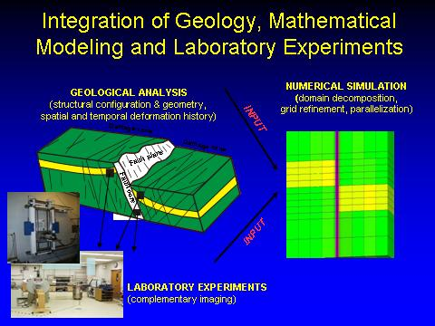
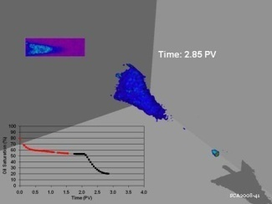
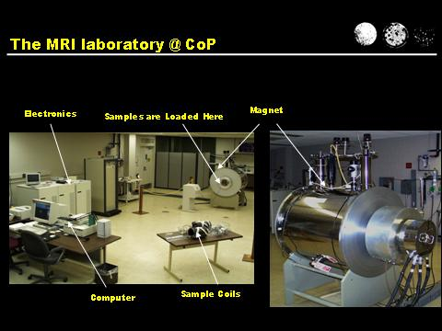
CCUS as EOR:
Integrated EOR (IEOR) for CO₂ Sequestration
CO₂ Foam for Mobility Control for EOR in
Fractured Reservoirs in Texas
Collaboration: 11 Universities in France, The Netherlands, UK, USA and Norway
Coordinator: Arne Graue, Dept. of Physics, University of Bergen, NORWAY
Funding: The Research Council of Norway and oil companies
Lab to pilot field test
MRI of CO₂ injection
Complementary NTI & MRI facilities

Slide 6
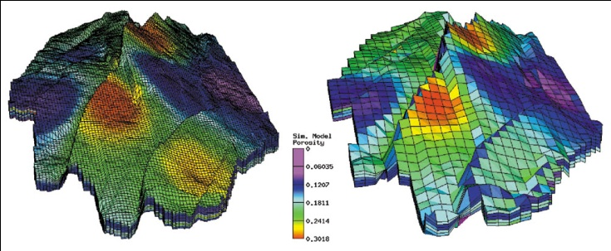
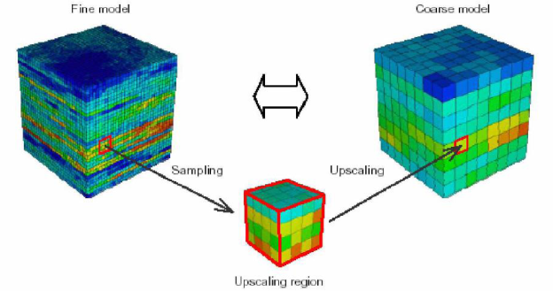
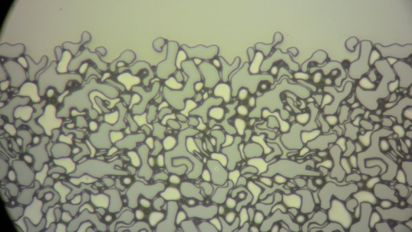
10⁴-10⁶m
Petroleum Geo-Services Homepage www.pgs.com
10¹-10³m
GRIDBLOCK SCALE
Length Scales
Numerical Simulations
10⁻¹-10⁰m
BLOCKSCALE
Nuclear Tracer
10⁻³-10⁻²m
CORESCALE
Imaging techniques
MRI and CT
10⁻⁵-10⁻³m
MICROSCALE
Microscopy

Slide 7
Project advantages:
- CO₂ is commercially available
- Foam as mobility control
- Researchers from 11 reputational universities
- Up-scaling; major challenge in oil recovery
- Fraction of costs of off-shore field tests
- Fast results: short inter-well distances
- 30 years experience in Texas on CO₂ EOR
- 4D seismic establishes a field laboratory
CO₂ Foam for Mobility Control for EOR in Fractured Reservoirs in Texas

Slide 8
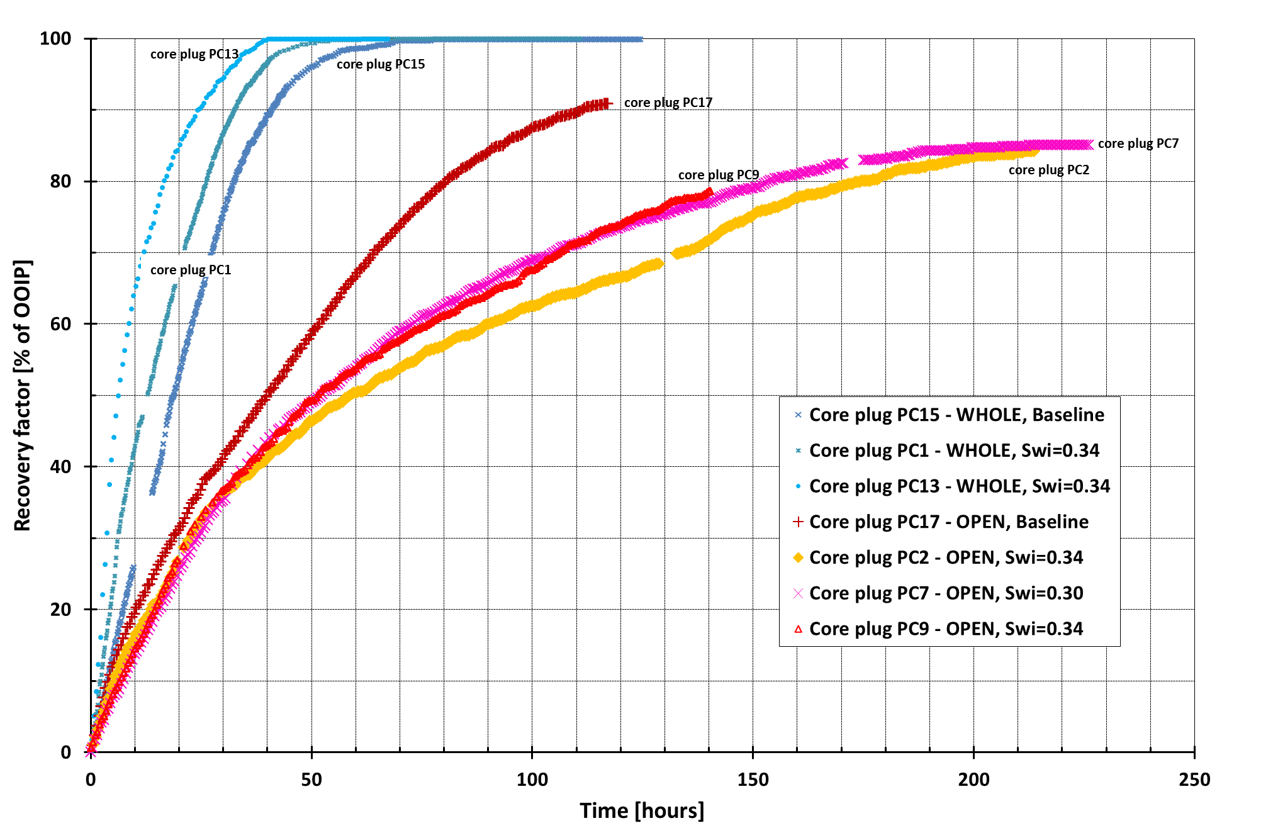
Secondary CO₂ injection in whole and fractured core plugs
Core | State | Swi | K_{mat} [mD] | K_{frac} [mD] | S_{OR} | RF @ 1 PV | RF @ 2 PV | RF_{tot} | PV @ RF_{tot}
PC1 | WHOLE | 0.34 | 3.7 | n.a. | 0.00 | 0.93 | 1.00 | 1.00 | 1.6
PC13 | WHOLE | 0.34 | 3.8 | n.a. | 0.00 | 0.82 | 0.98 | 1.00 | 2.1
PC2 | OPEN | 0.34 | 3.4 | 2247 | 0.10 | 0.28 | 0.40 | 0.84 | 11.2*
PC7 | OPEN | 0.30 | 3.2 | 1855 | 0.10 | 0.24 | 0.41 | 0.85 | 11.6
PC9 | OPEN | 0.35 | 3.5 | 2190 | 0.14 | 0.25 | 0.41 | 0.79 | 7.5*

Slide 9
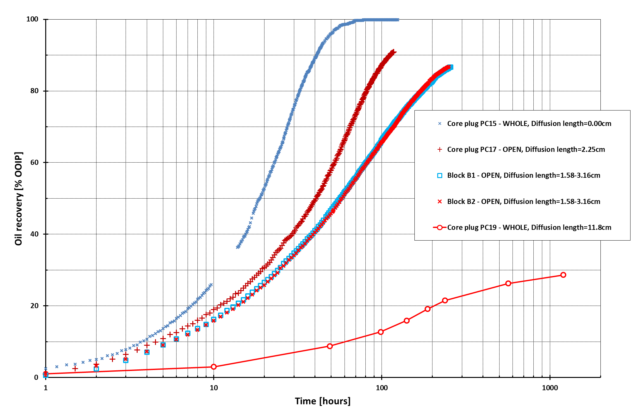
Length of diffusion and oil recovery during CO₂ injection in fractured systems

Slide 10
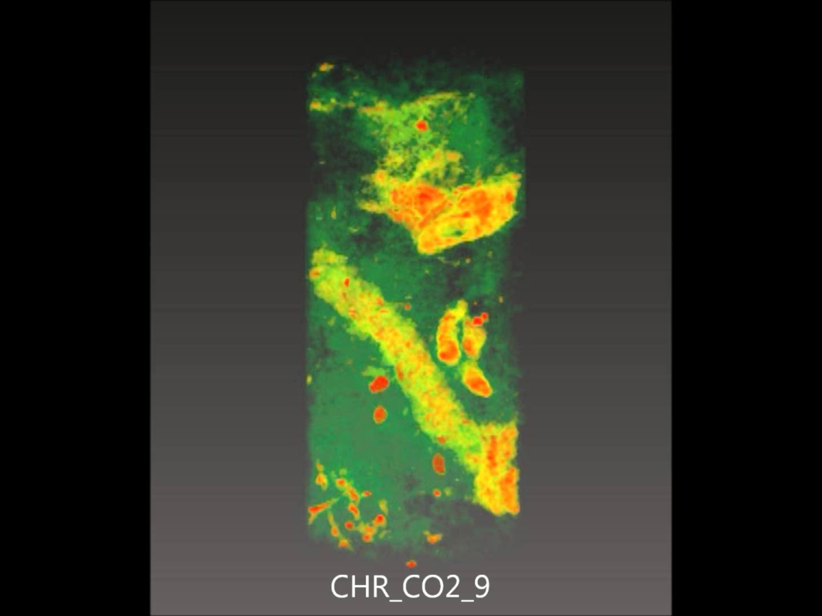
CT-imaging of CO₂ core floods
  Normalization scan:
    Dry core
    100% CO₂ saturated
    100% oil saturated
  Provides
    Porosity map of core
    Spatial fluid saturation
  Resolution: 0.156mm*0.156mm*0.5 mm
Notes:
Forklar hvordan CT scanning fungerer
Forklar hvorfor vi trenger normaliseringsskann
Vis film av det tørre scannet av kjernen, der lave tettheter er gjort transparent for å vise restene av organisk aktivitet i kjernen

Slide 11
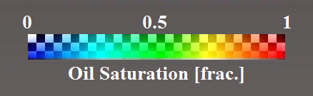
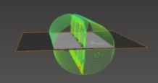
XY-plane
0.0 hrs
XZ-plane

Slide 12
XY-plane
0.8 hrs
XZ-plane

Slide 13
XY-plane
1.1 hrs
XZ-plane

Slide 14
XY-plane
1.8 hrs
XZ-plane

Slide 15
XY-plane
2.3 hrs
XZ-plane

Slide 16
XY-plane
2.8 hrs
XZ-plane

Slide 17
XY-plane
3.1 hrs
XZ-plane

Slide 18
XY-plane
3.7 hrs
XZ-plane

Slide 19
XY-plane
4.2 hrs
XZ-plane

Slide 20
XY-plane
4.7 hrs
XZ-plane

Slide 21
XY-plane
5.7 hrs
XZ-plane

Slide 22
XY-plane
13.6 hrs
XZ-plane

Slide 23
XY-plane
20.4 hrs
XZ-plane

Slide 24
XY-plane
23.3 hrs
XZ-plane

Slide 25
XY-plane
25.9 hrs
XZ-plane

Slide 26
XY-plane
28.8 hrs
XZ-plane

Slide 27
XY-plane
45.6 hrs
XZ-plane

Slide 28
XY-plane
56.8 hrs
XZ-plane

Slide 29
XY-plane
72.6 hrs
XZ-plane

Slide 30
XY-plane
93.3 hrs
XZ-plane

Slide 31
XY-plane
97.3 hrs
XZ-plane

Slide 32
XY-plane
102.1 hrs
XZ-plane

Slide 33
XY-plane
R_{f} = 96.0 %
117.8 hrs
XZ-plane

Slide 34
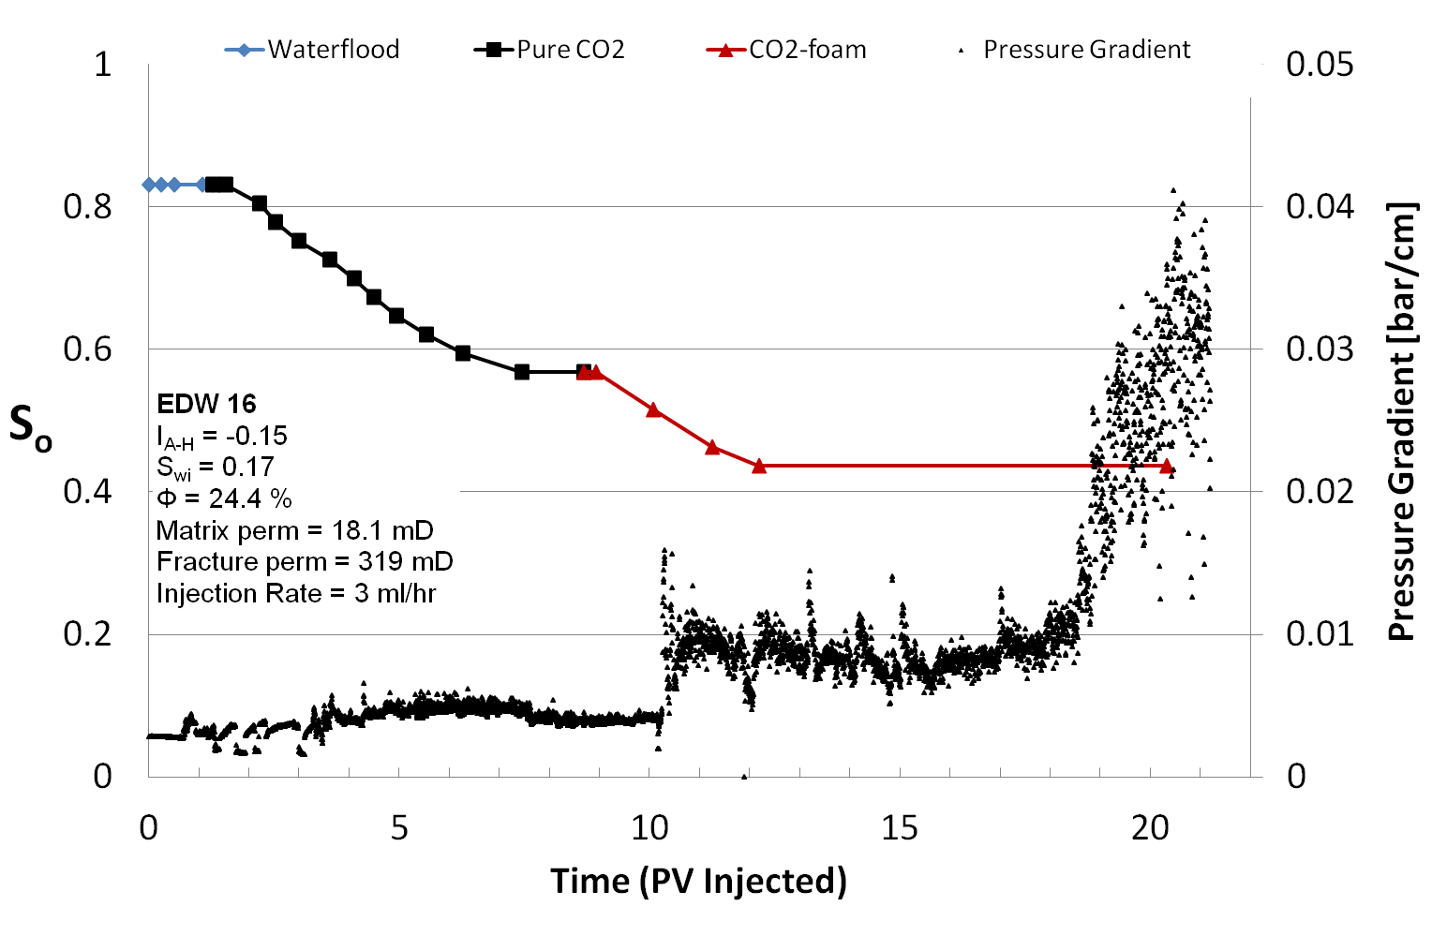
Oil-Wet Carbonate Core Plugs:
IEOR (WF + CO₂ + CO₂-foam)

Slide 35
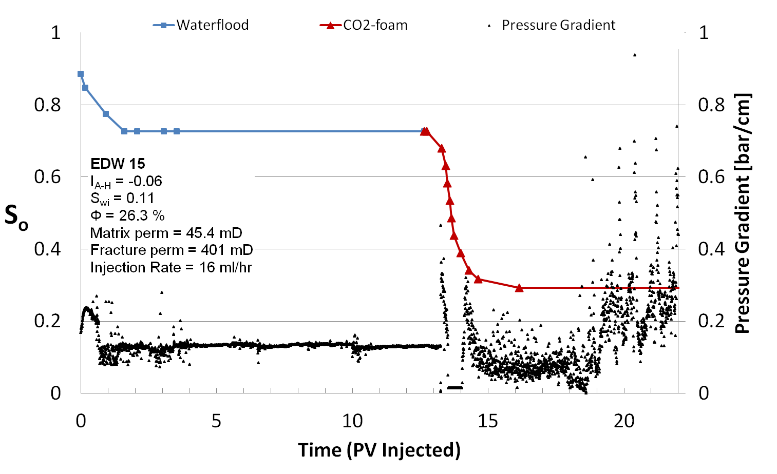
Oil-Wet Carbonate Core Plugs:
IEOR (WF+CO₂-foam)

Slide 36
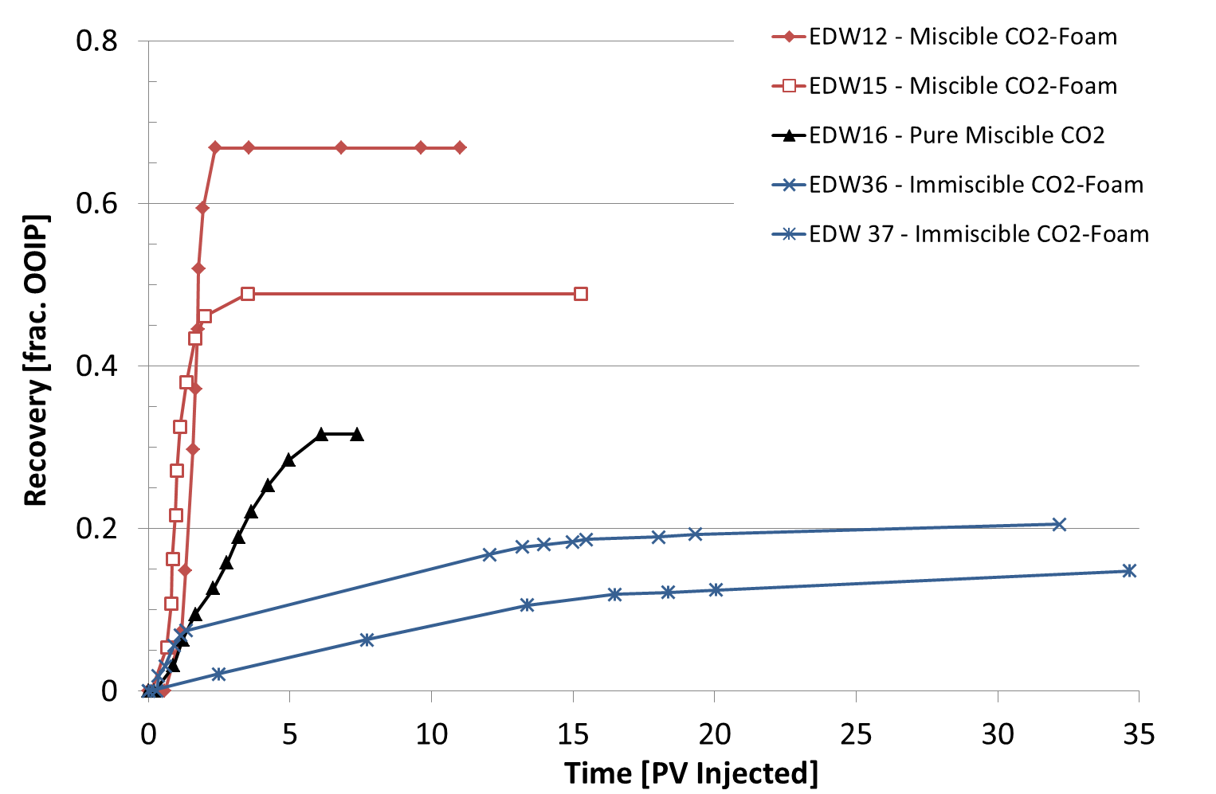
Comparison between miscible CO₂ injection and immiscible and miscible CO₂-foam

Slide 37
Thank you!

